Slide 1
Data Analysis in Python Pt. 2: Unsupervised Learning

Slide 2
Agenda for Today
Clustering
Dimensionality reduction
Homework

Slide 3
Last time: Supervised Learning
Input Data:
X: Data Matrix
Y: Label vector
Features
Label
Samples
Samples
Goal: Train a model to learn the relationship between X and Y

Slide 4
Unsupervised Learning
Input Data:
X: Data Matrix
Y: Label vector
Features
Label
Samples
Samples
Goal: Train a model to find hidden structure in X

Slide 5
Clustering
Goal: identify distinct groups of samples in the data

Slide 6
Clustering
Goal: identify distinct groups of samples in the data
More formally, we want to find an assignment of samples to groups that
Maximize similarity of samples within groups
Maximize dissimilarity of samples between groups

Slide 8
Clustering step 1: assign samples to groups

Slide 9
Clustering step 2: evaluate the quality of the assigned clusters
Within group distances

Slide 10
Clustering step 2: evaluate the quality of the assigned clusters
Between group distances

Slide 11
Optimal assignment of clusters

Slide 12
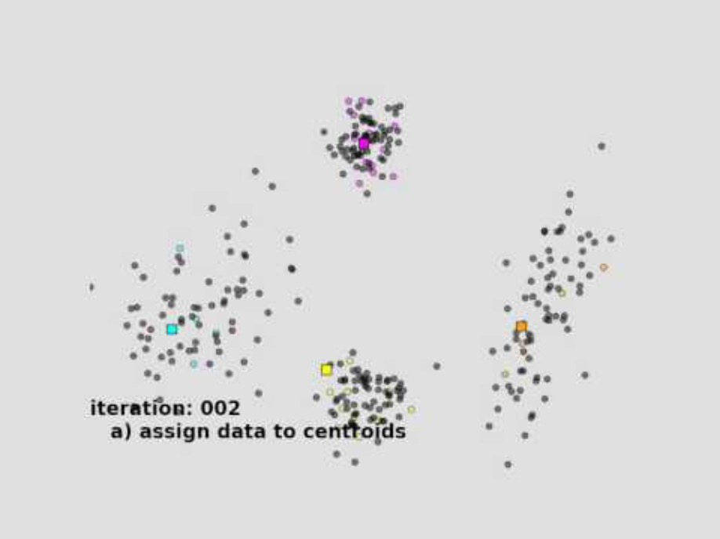
K-means clustering

Slide 13
Running K-means clustering using scikit-learn
https://scikit-learn.org/stable/modules/generated/sklearn.cluster.KMeans.html

Slide 14
Some popular clustering algorithms
K-means clustering
Hierarchical clustering
Agglomerative
Divisive
Louvain

Slide 15
Dimensionality reduction
Goal: summarize the data in fewer variables
Purpose:
Visualization
Noise reduction
Computational considerations
Inference

Slide 16
Data often has some lower-dimensional, “intrinsic” dimension

Slide 17
Sometimes, intrinsic dimensionality is due to interpretable factors
~1000 human TFs
~20,000 human genes

Slide 18
Dimensionality reduction algorithms make assumptions about relationships among variables to reduce the data
PCA: Linear combinations of features are perpendicular

Slide 19
Dimensionality reduction algorithms make assumptions about relationships among variables to reduce the data
PCA: Linear combinations of features are perpendicular
https://scikit-learn.org/stable/modules/generated/sklearn.decomposition.PCA.html

Slide 20
Dimensionality reduction algorithms make assumptions about relationships among variables to reduce the data
PCA: Linear combinations of features are perpendicular
ICA: Sets of features are statistically independent
Factor Analysis: High-dimensional features are explained by a set of low-dimensional factors

Slide 21
Some common dimensionality algorithms
Linear
PCA
ICA
Non-negative matrix factorization
Nonlinear
tSNE
UMAP
Kernel PCA
Autoencoder

Slide 22
Your homework

Slide 23
Course overview
Basic Python coding skills
Best practices for setting up a data analysis pipeline
GitHub
Conda
Data loading and manipulation tools
Pandas
Numpy
Data visualization
Plotnine
Machine learning
Sci-kit learn

Slide 24
Course overview
Basic Python coding skills
Best practices for setting up a data analysis pipeline
GitHub
Conda
Data loading and manipulation tools
Pandas
Numpy
Data visualization
Plotnine
Machine learning
Sci-kit learn

Slide 25
Thank you!

